Slide 1
AIML CA1:
Binary Classification/ Regression
Muhammad Fitri Amir bin Abdullah
DAAA/FT/2A/06
2222811

Slide 2
Steps for both tasks:
Exploratory Data Analysis | Find out more about the dataset
Visualisation | Show the variance of the data, count etc
Data Preprocessing | Scaling the data, encoding etc
Baseline Model | Using a dummy classifier/regressor
Model Selection | Picking which model is the best to use in the task
Model Improvement | Improving the results obtained by chosen model

Slide 3
Table of contents
01
02
Default Payment Classification
Housing Prices Regression
In this task, I aim to predict customers of a bank who will have default payment next month.
In this task, I aim to build a regression machine learning model to predict the prices of housing.

Slide 4
01
Default Payment Classification

Slide 5
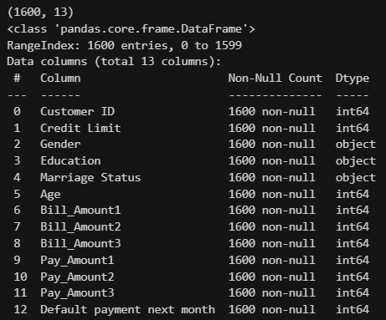
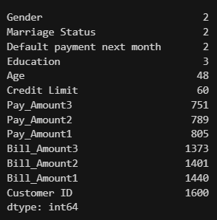
Exploratory Data Analysis
-From the outputs, we can see that there are 3 categorical features, gender, education, marriage status.
-The other features are all numerical.
-There are a total of 1600 data points and 13 columns, including the target variable, in this case ‘Default payment next month’
-All features have more than 1 unique value, hence most can be used in the model training.

Slide 6
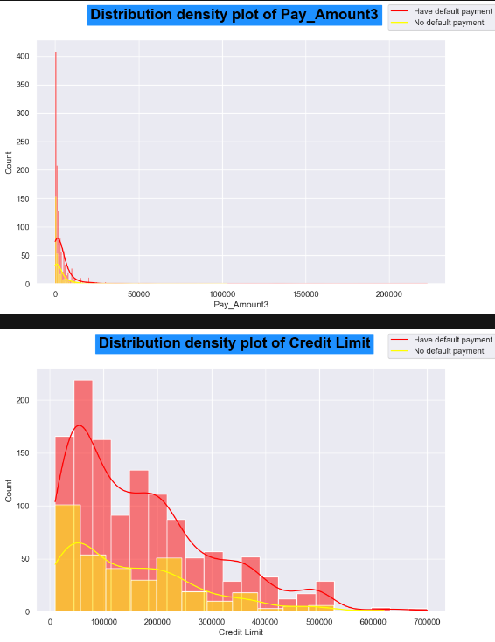
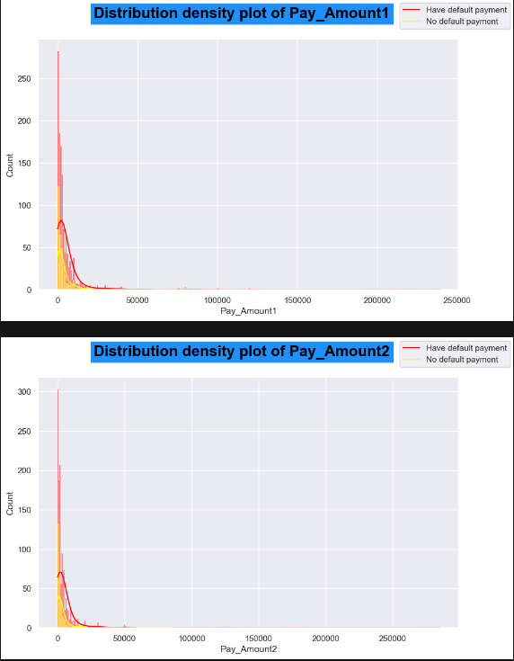
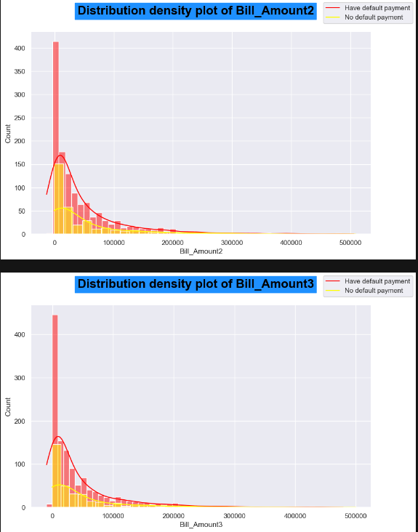
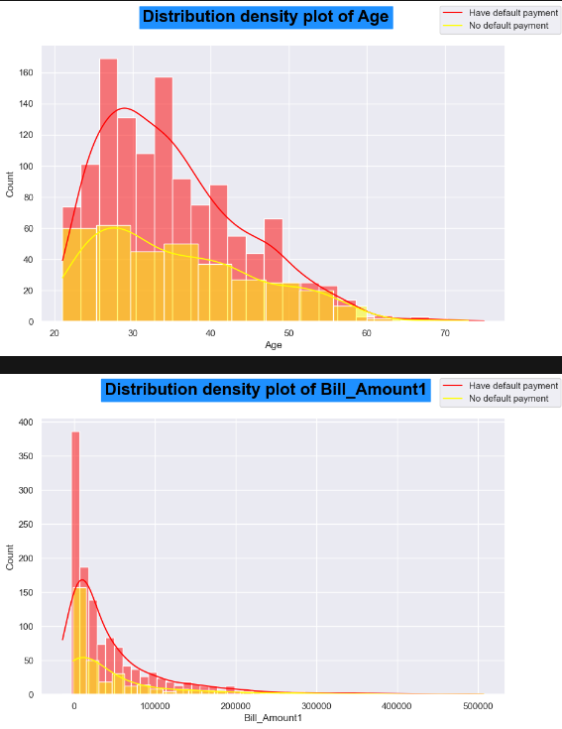
Visualisation
Looking at the distribution of the plots, they are mostly very positively skewed. This means that I have to fix it before using (as a lot of models require a normalised dataset).
We can also see that there’s a slight pattern in some features, such has older customers tend to have default payment, and those with a higher credit limit have default payment too.

Slide 7
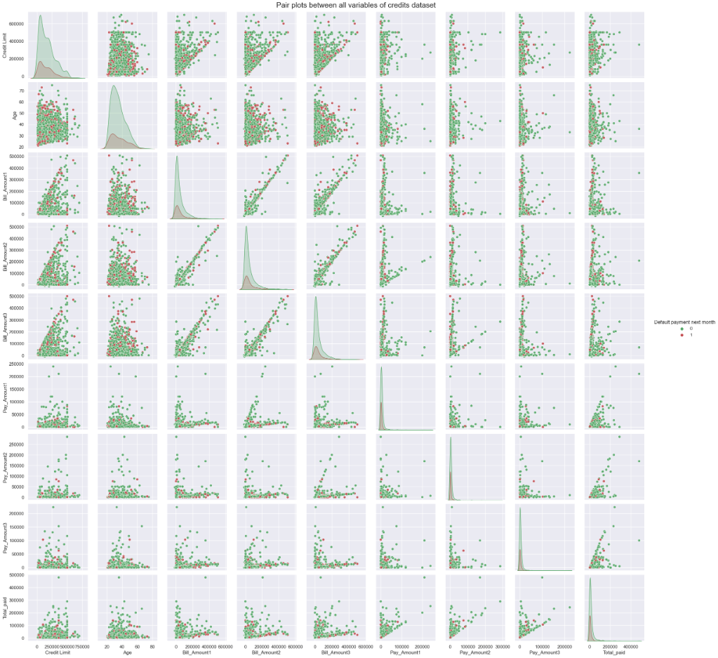
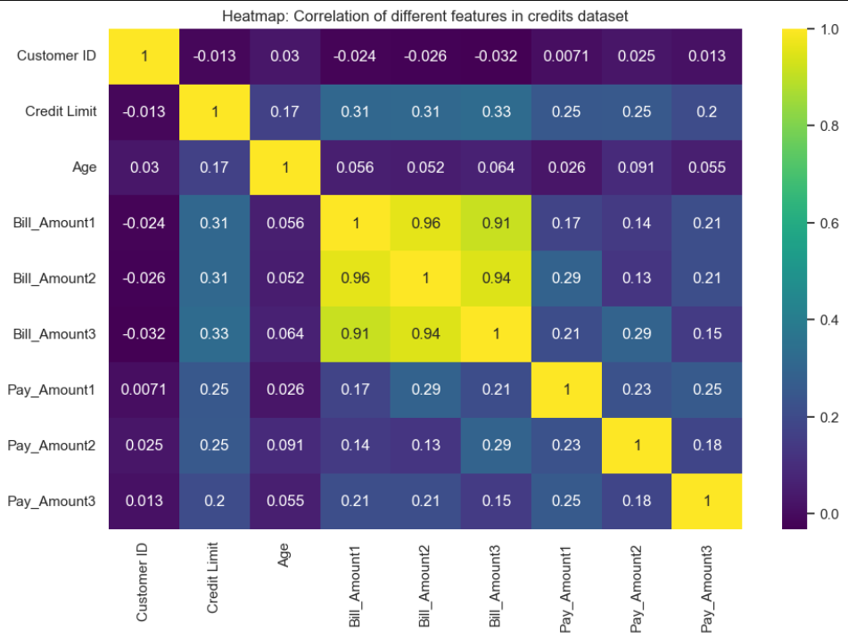
Visualisation
We can see that there are not many correlations between the variables. This is good as it avoids multicollinearity between the features, which would mean that we would need to drop some variables.

Slide 8
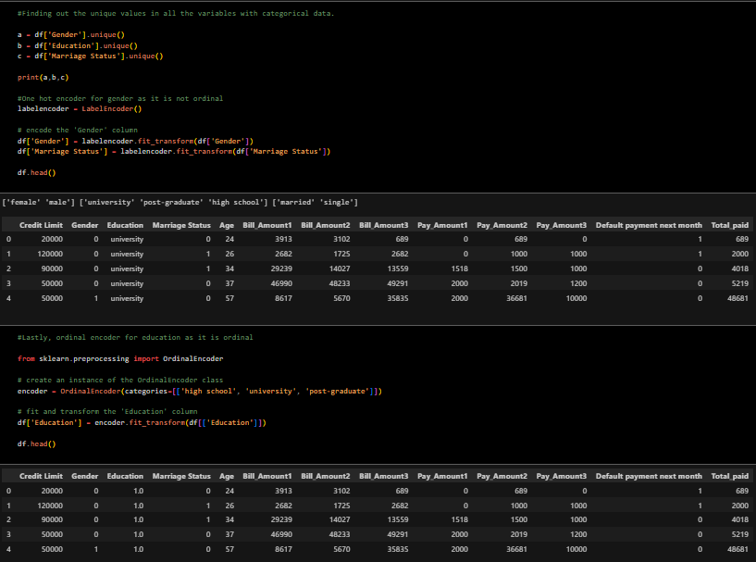
Feature Engineering/Data Preprocessing
Next, in my feature engineering, I label encoded marriage status and gender as they have no order, while ordinal encoding education as there is a hierarchy to education level.
I also fixed the typo of university in the dataset so that I do not mess up the spelling in later codes.

Slide 9
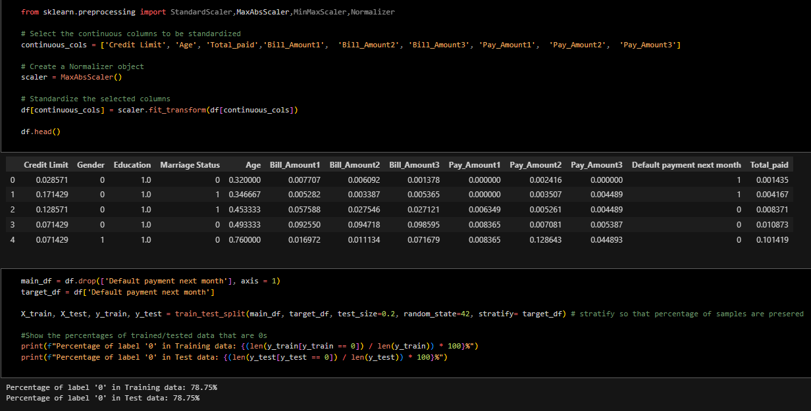
Feature Engineering/Data Preprocessing
As mentioned in my visualisation, due to how skewered the data is, I am required to scale the data, where I used max absolute scaler. This is because after thorough research, I feel that it works best with the values in the given dataset.

Slide 10
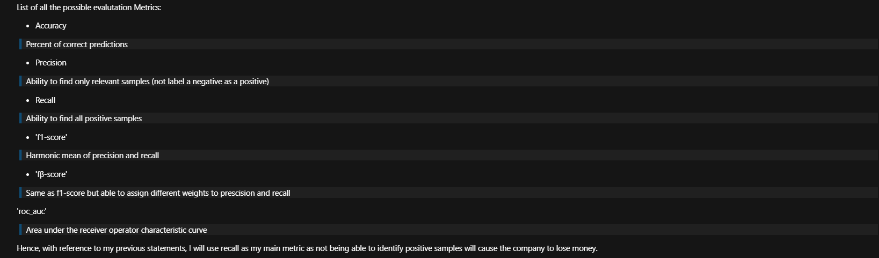
Baseline Model
Next, before I start using any models, I have to decide on my main scoring metric. As this is for a company, they would most likely want to lose as little money as possible. Therefore, to do that, they will need to identify all the true positives correctly.
Hence, I decided that recall would be the best metric as it would allow me to identify the model with the best true positive detection rate.

Slide 11
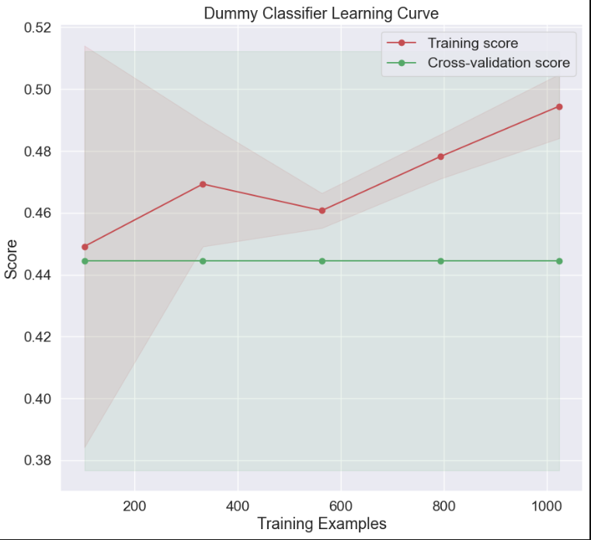
Baseline Model
Next, I plotted the learning curve of the training recall score.
As we can see, the final training score is slightly under 50%, which is to be expected as the baseline model is basically a guess and check machine (no biasness, just randomly guessing between 0 or 1).
Therefore, the results are expected to be bad or around 50%.

Slide 12
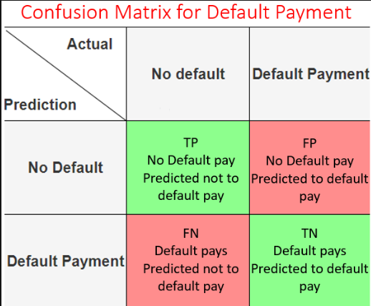
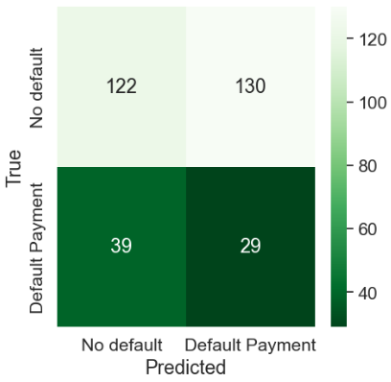
Baseline Model
Next, I plotted the confusion matrix of the training recall score.
Note that because of how 0s and 1s work in a confusion matrix, our bottom right is now the True Positive. This is because we would like to find out who has to default pay, making them the positive.
Hence, we can see that the baseline model guesses 29/68 of the people who need to default pay correctly, which is close to 50%.

Slide 13
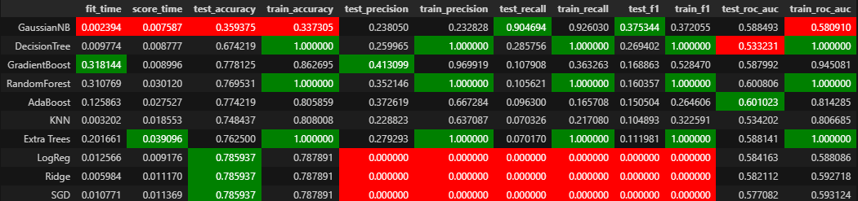
Model Selection
Next, I picked a few random models that are available by scikit learn and trained the models while sorting by recall test score. We can see that Gaussian Naive Bayes does the best among all the models by a large margin, hence we shall be using it.
To decide the rest of the models, I would like to pick a mix of classical and ensemble models, which each have their own benefits and losses (refer to notebook for clearer explanation.) Hence, I picked Random Forest and Gradient Boost for ensemble, and Gaussian Naive Bayes and Decision Tree for classical.

Slide 14
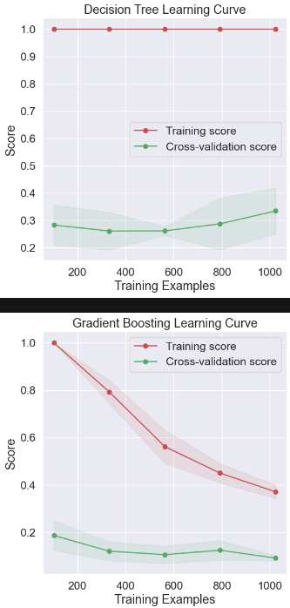
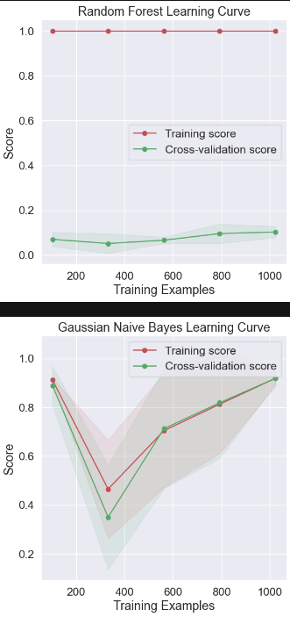
Model Selection
From the graphs, we can see that the learning curve of GNB is the highest as expected, and the other 3 models do not predict anywhere close.
Lets check the confusion matrices to see if they are worth using.

Slide 15
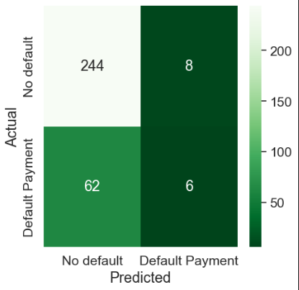
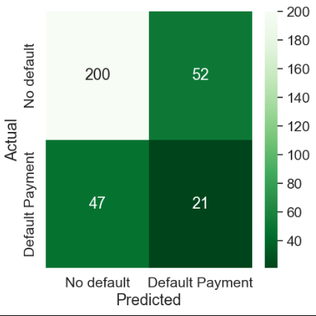
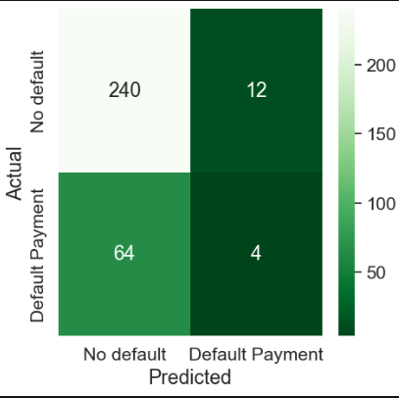
Model Selection
As we can see, none of the other models can be used.

Slide 16
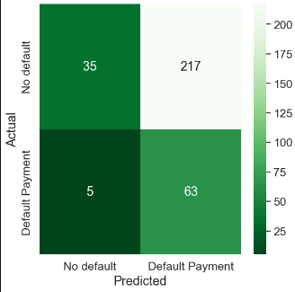
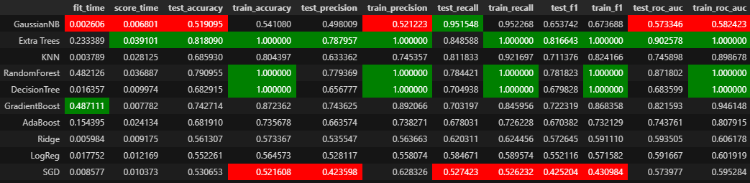
Model Improvement
To improve the model, I hyperparameter tuned the model using Grid Search first, and then oversampled using ADASYN. The results were much better percentage wise. To conclude, I would use GaussianNB for this task.

Slide 17
02
Housing Prices Regression

Slide 18
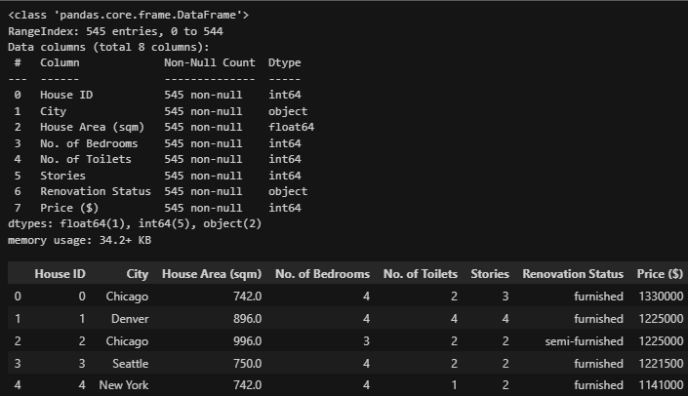
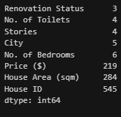
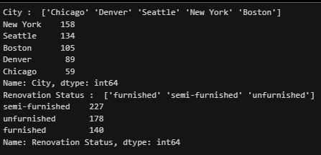
Exploratory Data Analysis
-From the outputs, we can see that there are 2 categorical features, city and renovation status
-The other features are all numerical.
-There are a total of 545 data points and 8 columns, including the target variable, in this case ‘Price ($)’
-All features have more than 1 unique value, hence most can be used in the model training.

Slide 19
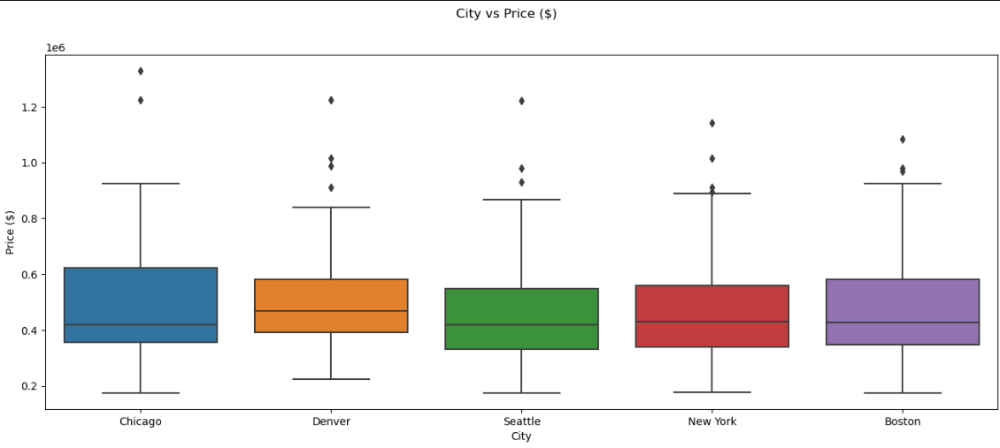
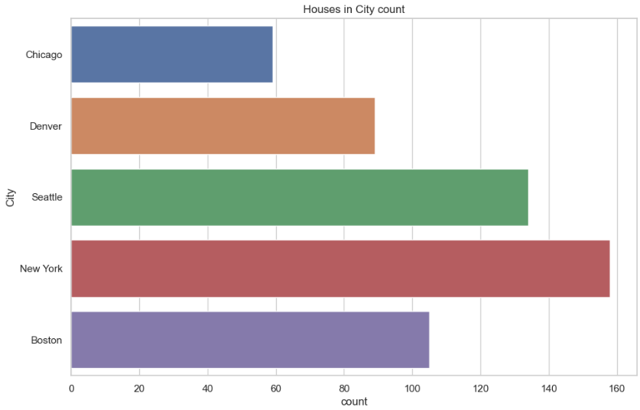
Visualisation
Looking at the prices of housing in different cities, we can see that the prices are more consistent in Denver and the highest costing house is in Chicago. We can also see that Denver has the highest housing cost average.
Most of the houses in the dataset are from New York, as shown by the plot of the count of houses.

Slide 20
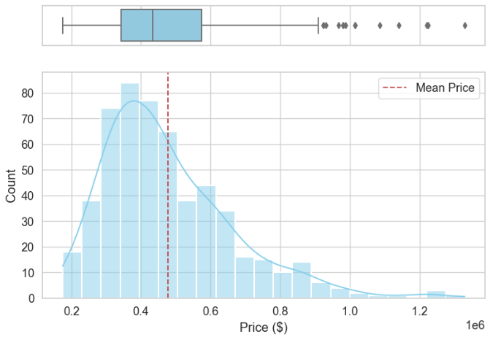
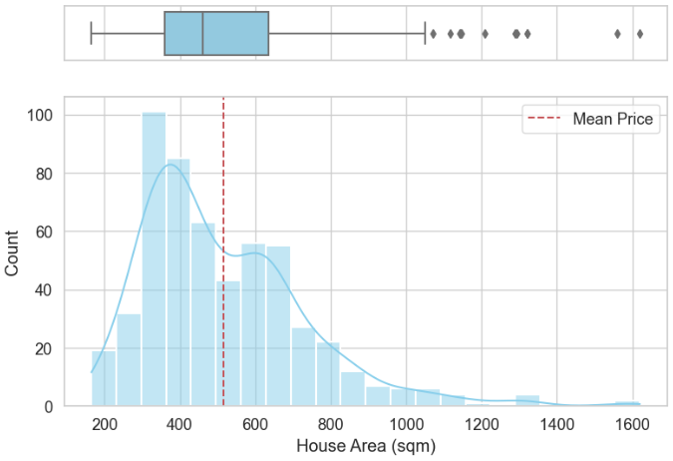
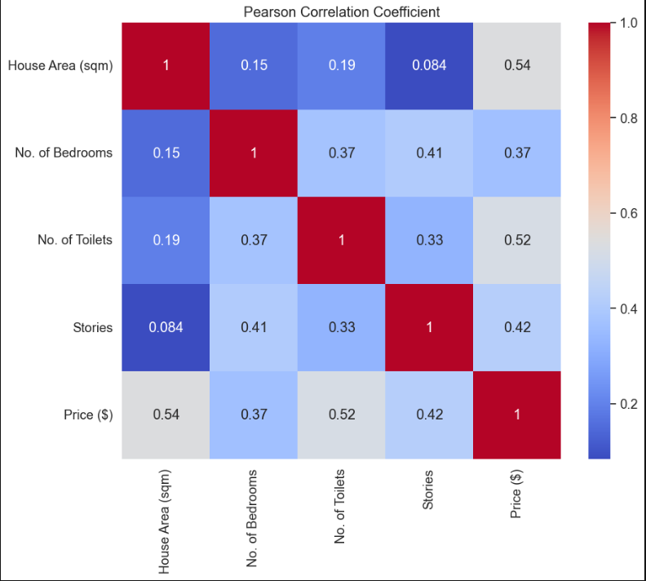
Visualisation
From the 2 distribution plots, we can see that both are slightly positively skewed. Price has a normal distribution despite being skewed, and house area is bimodal.
We can see that there are not many correlations between the variables. This is good as it avoids multicollinearity between the features, which would mean that we would need to drop some variables.

Slide 21
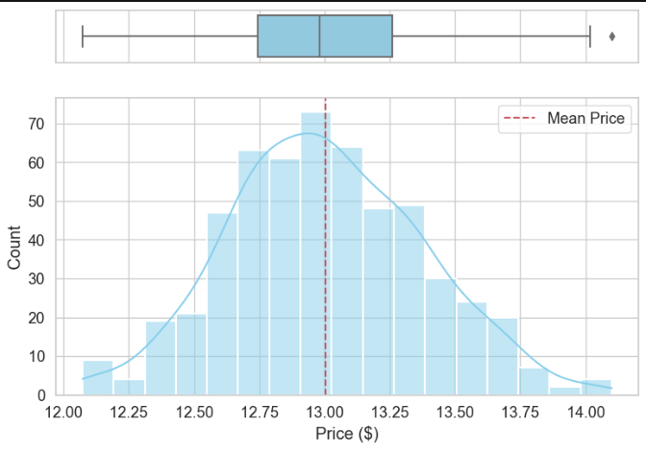
Feature Engineering/Data Preprocessing
Next, to engineer the data, I log transformed the target variable first. This was to remove the skewness of the data, which would improve model performance and keep the data in a good range.

Slide 22
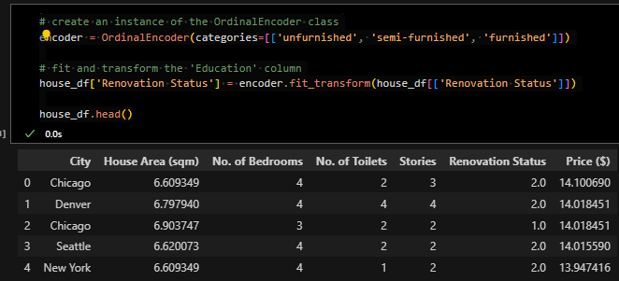
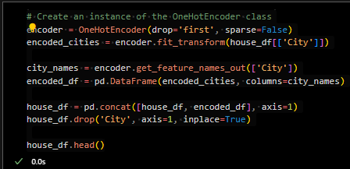
Feature Engineering/Data Preprocessing
Next, I encoded the categorical values. For the Renovation status, as there is an order (unfurnished to furnished), I used an ordinal encoder. However, for city, as there is no order, I used a one hot encoder.

Slide 23
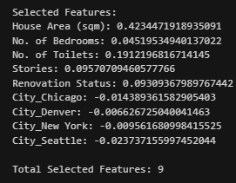
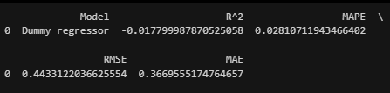
Baseline Model
Next, before I start using any models, I selected the features and used a baseline regressor in order to find the results. The numbers are very low as I transformed and scaled the data. I picked the 4 scoring metrics as I felt they would give me a good idea of the fit, accuracy and prediction errors of the models. I further explained it in depth in my notebook.

Slide 24
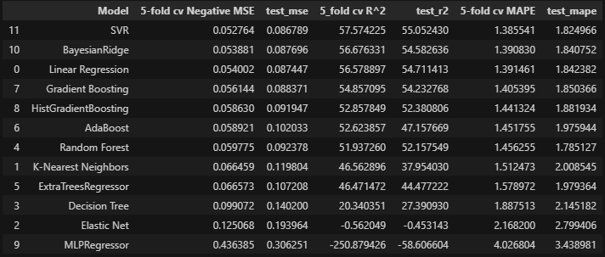
Model Selection
I picked the models by random from research I did online. I mainly sorted these values by their r square value as I feel that getting a read on the quality of fit of the models is very important. Hence, by looking at the r square scores, we can see that SVR is the most fitting in this task.

Slide 25
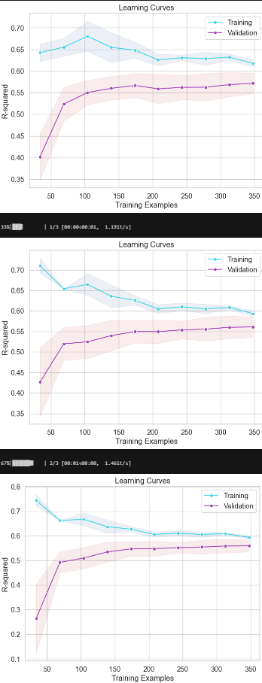
Model Selection
From the learning curves, we can see that most of the models generally did better when more samples were fed, but none of them performed as well as SVR. The training scores were also much higher than the validation scores as expected.

Slide 26
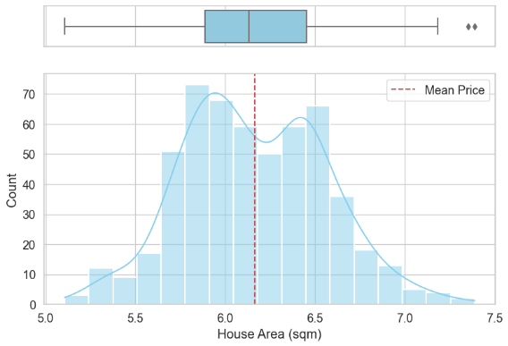
Model Improvement
As mentioned in my notebook, I first dropped the outliers that are seen in the graph on the right. I could not fix the bimodality of the data, but I think it won’t affect my results.

Slide 27
Model Improvement
Then I hyperparameter tuned my SVR. I used a genetic algorithm instead of GridSearch or RandomSearch, and I explained the benefits in my notebook. Generally it:
-Detects nonlinearity and interactions
-Has an auto feature selection
-Reduces overfitting.
Next, I scaled all my numerical features to put it into similar ranges. However, as seen in the notebook, it didn’t improve too much. Therefore, I had to include another extra feature.

Slide 28

Model Improvement
To try my best to solve this problem, I stacked some models (mainly the three best ones I saw in my Model selection)
This produces inconsistent results; as high as 75% R square but sometimes as low as 40%

Slide 29
Thank you!

